Slide 1
Introduction to Social Work
Imran Ahmad Sajid, PhD

Slide 3
Imagine a society where

Slide 4

Everybody is YOUNG?

Slide 5
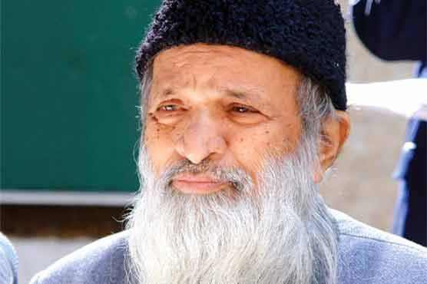
Nobody is OLD?

Slide 6


Everybody is WEALTHY?

Slide 7


Everybody is HEALTHY:?

Slide 8

Everybody gets the DREAM JOB?

Slide 9
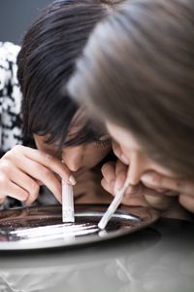
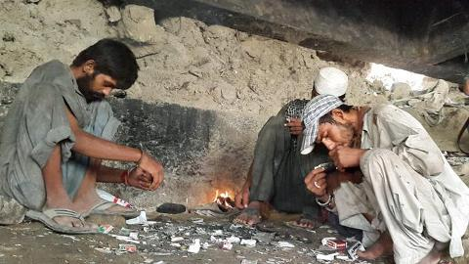
No DRUG ABUSE problem?

Slide 10
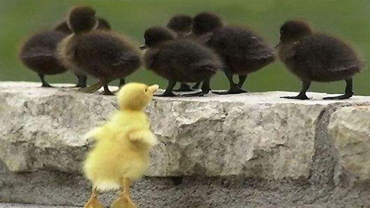

No DISCRIMINATION?

Slide 11

No CRIME?

Slide 12
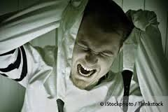
No MENTAL HEALTH Problems?

Slide 13
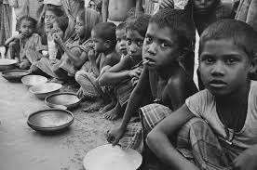
No POVERTY?

Slide 14
No:
Because human societies are not perfect.
Social problems emerge which require solutions.

Slide 15
Do you feel concerned when

Slide 16
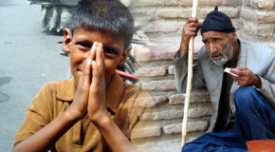
You see people beg in the street?

Slide 17
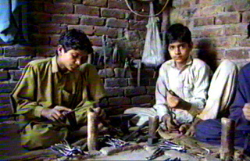
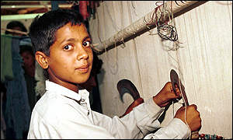
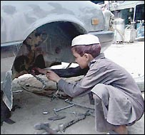
Children do not go to school and work as a labour?

Slide 18
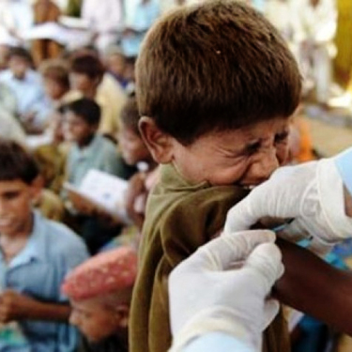

Poor go untreated because health care is not AFFORDABLE?

Slide 19
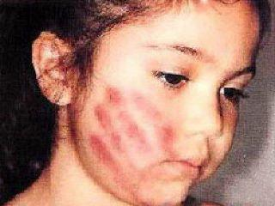
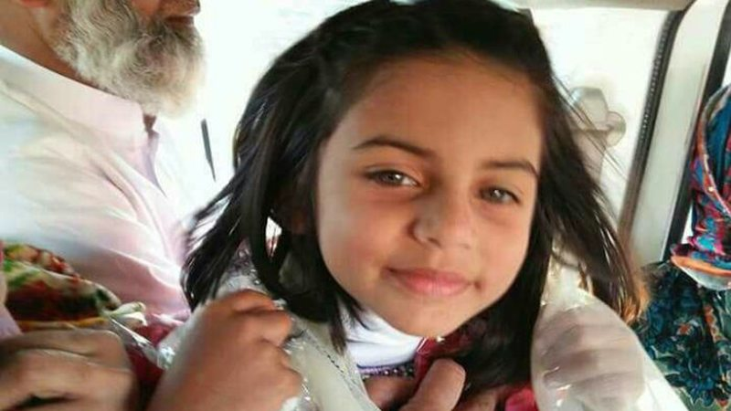
When children are physically and sexually abused?

Slide 20
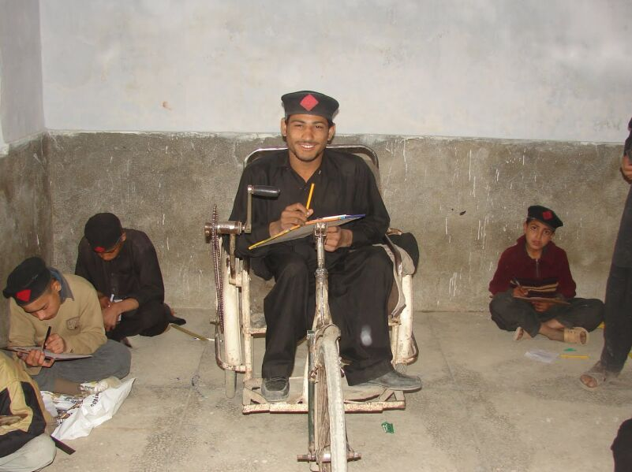
When disable are discriminated and left behind?

Slide 21

When you see domestic violence?

Slide 22
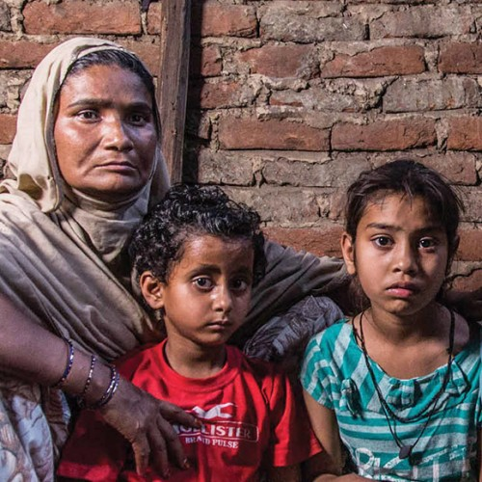
When you see widows and orphans uncared for?

Slide 23
If yes then
WELCOME TO SOCIAL WORK

Slide 24
What is Social Work

Slide 25
Social work defined
Social work is the professional activity of helping individuals, groups, and communities to enhance or restore their capacity for social functioning* and to create societal conditions favourable to their goals.
  National Association of social workers USA
*The ability of a person to interact easily and successfully with other people.

Slide 26
Social work defined
Very simply we can say
Social work is a helping profession to help people overcome their problems.
Helping people cope more effectively with their problems in social functioning.

Slide 27
International Federation of Social workers (IFSW) & International Association of School Social Workers (IASSW) in July 2000
“The social work profession promotes social change, problem-solving in human relationships, and the empowerment and liberation of people to enhance well-being.
Utilizing theories of human behavior and social system, social work intervenes at the point where people interact with their environments.
Principles of human rights and Social justice are fundamental to social work.
Defining social work for 21st century. Journal of International Social work. vol.47 No.3. July 2004

Slide 28
Knowledge-base of Social Work
From the definition of IASSW it is clear that SW has borrowed its knowledge base from a variety of subjects like Psychology, sociology, psychiatry, biology, economics, political science etc .
Thus there is a relationship between SW and these subject as below

Slide 29
Social
Work
profession
Psychology:-
The scientific study of Mind and behaviour
Sociology:-
The organized study of how groups develops interact, behave and Function within the society
Micro practice
(Individuals)
Pol. Science: T
he study of pol.
& govt. structures& Functioning
Micro/mezzo
Practice
(Families)
Economics ;
The study of the Production,
distribution &consumption of
goods & services
Mezzo Practice
(Groups)
Biology:
The study of living organisms
and their physical Functions.
Macro practice
Organizations and Communities
Psychiatry:
the diagnosis & treatment of mental,
Emotional & behavioral disorders
Anthropology;-the study of human culture
Specially Its history, social structure,
language And technology
Social work;-The practical application of knowledge,
skills and values to enhance the well –Being of inds.,
gps, orgns. and communities
Notes:
The social work knowledge base

Slide 30
Goals and Objectives of Social Work
Imran Ahmad Sajid,
Lecturer (Social Work),
University of Peshawar
imranahmad131@gmail.com

Slide 31
Dictionary meaning of Goal and Objective
Dictionary meaning of goal is “target area”, or
“the desired results an individual or organization plans and commits to achieve”.
In Urdu, the word goal is translated asمقصود، منزل مقصود، مطمع نظر، نصب العین
Objectives: dictionary meaning of “A specific result that a person or system aims to achieve within a timeframe.”
Function: an action or use for which something is suited or designed

Slide 32
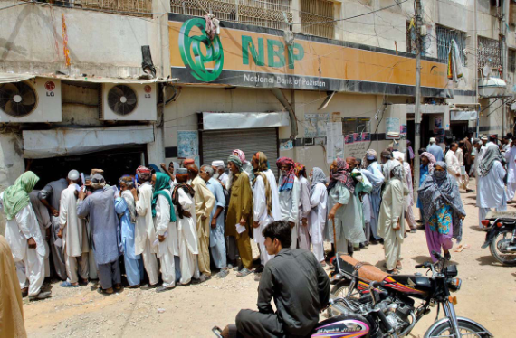

Goal of Social Work
* the degree of enjoyment and satisfaction experienced in everyday life as opposed to financial or material well-being
“promote[ing] or restore[ing] a mutually beneficial interaction between individuals and society in order to improve the quality of life*for every one.

Slide 33
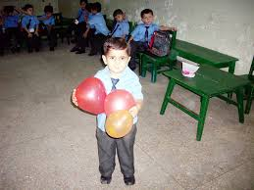
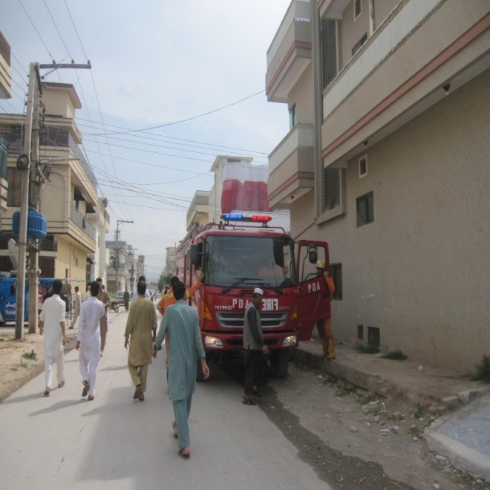
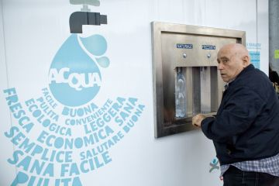
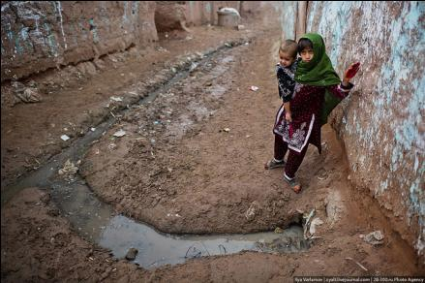
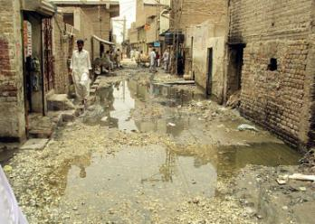
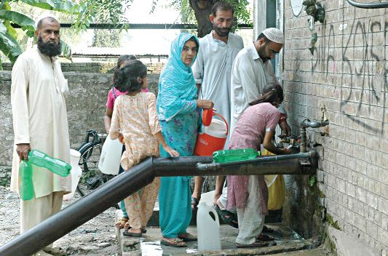

Slide 34
Objectives / Functions of Social Work
Social Work practice has at least four major objectives, namely
Empowering people →or Enhance the people’s capacities to resolve problem, cope, and function effectively;
Linking clients with systems/needed resources
Improve the social services delivery network
Promote Social Justice through the development of social policy

Slide 35
Fields and Services of Social Work
Family and Child Services
Health and Rehabilitation Services
Mental Health
Information and Referral
Occupational Social Work
Juvenile and Adult Correction
Gerontological Social Work
School Social Work
Housing Services
Income Maintenance
Community Organization

Slide 36
Fields of social work practice
In the west social work practice fields are many. They include, traditionally;
1.Family and children services;-
a. Family preservation
b. day care ( both for children, aged and disabled)
C. Family Counseling
d. Prevention of child abuse and neglect
e. prevention of domestic violence.

Slide 37
2. Health and Rehabilitation
a. Hospital Social work
b. Public health work
Maternal health work
Vocational rehabilitation
e. Hospice care (for those who are dying).

Slide 38
3. Mental Health
a. Mental health clinics
b. Day treatment for drug and alcohol addiction
c. Community integration

Slide 39
4. Information & referral
a. Provision of information on resources
b. Publication of community directories
Notes:
c. First-call service

Slide 40
5. Occupational Social work
a. Employees assistance programme
b. Treatment for work related stress
c. Job relocation programme
d. Retirement planning

Slide 41
6. Juvenile & Adult Correction
a. Probation and Parole service
b. Police social work
Work in training schools
Prison work
Diversion services

Slide 42
7. Gerontological service
Young-Old
Middle-Old
Old-Old
a. In-home support
b. Respite help for family caregiver
c. Adult day care
d. Nursing home service
Centenarians

Slide 43
8. School Social work
School adjustment counseling
Family counseling
Behaviour management

Slide 44
9. Housing Services
a. Subsidized rents
b. Homeless shelters
c. Handicapped accessibility programmes

Slide 45
10.Income maintenance
a. Income support programmes
b. Food stamps/Food Support (Free Bazar)
c. Aid to families with dependent children

Slide 46
11. Community Organization
a. Social Planning
b. Community organization
c. Neighborhood revitalization

Slide 47
Fields of social work practices in Pakistan
With reference to Pakistan the fields of social work practices are;-
1. Special education
2. Mental Health social work
3. Drug addicts detoxification & rehabilitation
4. Women welfare
5. Child welfare

Slide 48
6. Pakistan Baitul- Mal
7. Zakat department
8. Labour welfare:- ESSI, EOABI,WWB
9. Day care centers
10. Staff welfare organization
11. Homes for the aged under public and private organizations
12. Mental asylum like Fountain house
13. Medical Social work
14. School social work (NCHD approach)
15. Student councilors.

Slide 49
Social Welfare
According to Barker (1999)
“ a nation’s system of programmes, benefits, and services that help people meet those social , economic, educational and health needs that are fundamental to the maintenance of society.”
Barker, R. L. (1999). The Social Work Dictionary (4th ed.). Washington, DC: National Association of Social Workers, c.f. Charles H. Zastrow. (2003). The Practice of Social Work: Applications of Generalist and Advanced Content. New York: Thomson/Brooks/Cole.p.5

Slide 50
Social services & social welfare services
Social services
refer to mean those services which are required on a very extensive scale by the normal population.
These services seek to meet the basic needs of the people and include services for health, education, housing, communication etc.

Slide 51
social welfare services
Not only in In Pakistani context but the entire ESCAP region the term is used to describe those services which are required by the vulnerable sections of the society and includes services for the handicapped and the traditionally under privileged groups such as minorities, women, children etc.

Slide 52
SOCAIL POLICY DEFINED
Social policy relates to the guidelines for the changing, maintenance or creation of living conditions that are conducive* to human welfare (Eldar Shafir, 2013).
[a policy is] a program of actions adopted by a person, group, or government, or the set of principles on which they are based
Microsoft® Encarta® 2009. © 1993-2008 Microsoft Corporation. All rights reserved.
*helping something to happen
Source: Eldar Shafir. (2013). The Behavioral Foundations of Public Policy. New Jersey: Princeton University Press.

Slide 53
The general accepted concept of social policy encompasses
education,
health,
housing,
social security*, including pension, and
The personal social services.
*a government program that provides economic security to people who are retired, unemployed, or unable to work.

Slide 54
Welfare State
Welfare state is a concept of government in which the state assumes the primary responsibility of social and economic well-being of its citizens.

Slide 55
Classification of Welfare States
Esping-Andersen classified the most developed welfare state systems into three categories;
  Social Democratic,
  Conservative, and
  Liberal.

Slide 56
Decommodification as a concept comes from the idea that in a market economy, individual persons (and their labor) are commodified.
Given that labor is the individual's primary commodity in the market, decommodification refers to activities and efforts (generally by the government) that reduce individuals' reliance on the market (and their labor) for their well-being.

Slide 57
1. Social Democrat Welfare States
HIGH →decommodification
The ideal social-democratic welfare state is based on the principle of
  universalism,
  granting access to benefits and services based on citizenship.
Such a welfare state is said to provide
  a relatively high degree of autonomy,
  limiting the reliance of family and market.
In this context, social policies are perceived as 'politics against the market’.

Slide 58
2. Christian Democrat (Conservative) Welfare States
Medium→decommodification
Christian-democratic welfare states are based on the principle of subsidiarity and the dominance of social insurance schemes, offering
  a medium level of decommodificationand*
  permitting a high degree of social stratification.

Slide 59
3. Liberal Welfare States
Low →decommodification
The liberal regime is based on market dominance and private provision;
ideally, the state only interferes to ameliorate poverty and provide for basic needs, largely on a means-tested basis*.
Hence, the decommodification potential of state benefits is assumed to be low and social stratification high.
*public assistance varying with income: a benefit or payment that is available according to the level of somebody's income, or whose value varies with the level of income

Slide 60
Based on the decommodification index, Esping-Andersen divided 18 OECD countries into the following groups:
  Social Democratic: Denmark, Finland, the Netherlands, Norway and Sweden
  Christian Democratic: Austria, Belgium, France, Germany, Spain and Italy;
  Liberal: Australia, Canada, Japan, Switzerland and the US;
  Not clearly classified: Ireland, New Zealand and the United Kingdom.

